Slide 1

Robotic Path Planning
and Navigation Control

Slide 2
Introduction
With the rapid growth in technology coupled with the increasing demands from the people and industry, one field that has emerged magnificently is robotics.
The robot needs to move in an environment that is filled with static and dynamic obstacles. There are paths where it may move, and regions where it may not be safe to move. Under all these cases, we need to ensure a collision-free navigation plan for each of the robots.
We use the AI and soft computing algorithms to find out the path of the robot, which turns out to be almost the optimal path possible. We make the use of three algorithms for the problem. These are genetic algorithm (GA), artificial neural network (ANN) with back propagation algorithm (BPA), and A* algorithm.

Slide 3
Introduction
we also design a robotic controller using a neuro-fuzzy system to physically move the robot in a way that avoids the obstacles.
The first problem that we deal with is the problem of path planning. Here we are given a robotic map. The map marks the presence and absence of obstacles along with the accessible and inaccessible regions. We need to devise a strategy to find a collision-free path for the robot from a predefined point (or source) to another predefined point (called a goal).
We make use of GA, ANN with BPA, and the A* algorithm to find out the optimal path for the robot. The robot physically moves according to these results using the designed controller that runs on the neuro-fuzzy system

Slide 4
Robotics And Simulation Model
The whole model includes modeling of the robot and environment, modeling of the algorithms, and modeling of the results, so that they may be implemented.
Robotic Hardware
The robot is a much generalized concept that may be applied in numerous applications and domains. Each has its own set of hardware specifications and design. The good design of a robot plays a very important role in fuel economy, ability of the robot to pass uneven, rough terrain, or to survive such extreme conditions.
The robotic hardware essentially consists of wheels, shafts that connect wheels to motors, motors that are responsible to turn the wheels of the robot. The speed of the motor decides the speed with which the robot moves.

Slide 5
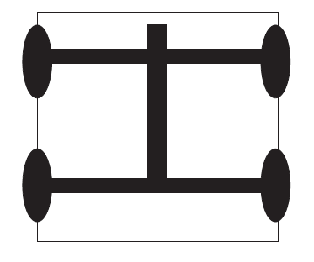
Robotics And Simulation Model
All the robot controls are interfaced with a computer that can send signals to the robot in order to control it.
The wheels and body of the robot and the various motor specifications depend upon the condition of use, terrain of movement, friction, and other mechanical parameters.
The car-like robot.

Slide 6
Robotics And Simulation Model
Robotic Sensors
The “autonomous” robots make extensive use of sensors to guide them in and enable them understand their environment. Numerous kinds of sensors are extensively used, including infrared and Bluetooth sensors.
GPS devices may also be used as sensors for planning purposes.
Often robots may need to receive and understand speech signals, especially if they are speech controlled robots.
Robotic Map
A map is a representation of the robotic world that useful for numerous purposes, especially for the purpose of path planning that we deal in this chapter. The robot gathers information on paths, obstacles, and accessible and inaccessible areas in numerous ways.

Slide 7
Robotics And Simulation Model
The information about the path is then converted into a map.
The most basic is a geometric map that has the whole information in form of a grid of size M × N.
Path Planning and Control
Path planning in robotics is the problem of devising a path or strategy to enable a robot to move from a prespecified source to a prespecified goal. The map thus generated needs to ensure that the robot does not collide with obstacles.
Important characteristic of the path planning algorithm is its optimality and completeness. Optimality refers to the quality of the path that the algorithm generates.
Completeness refers to the property that the algorithm is able to find a solution to the problem and return the solution in finite time, provided a solution exists.

Slide 8
Robotics And Simulation Model
AI Robotics and Applications
AI robotics makes use of AI techniques to enable robot do tasks autonomously, meaning that the robot does not require any human guidance to carry out the task.
General Assumptions
The robot we consider here is a general car-like robot. The robot makes use of some steering mechanism to steer itself at some angle. Further, the robot can move backward or forward using the controlling mechanism that moves the robot.
The path planning algorithms further are very sensitive to the complexities. Here we have to further limit the robotic moves and place suitable conditions on the map so that the problem can be solved.
The robotic map that we consider for the problem is divided in grids of M × N size.

Slide 9
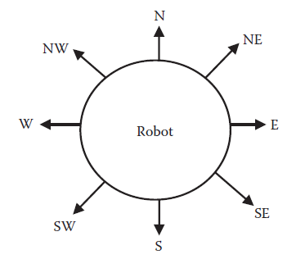
Robotics And Simulation Model
Following are the valid movements that can be performed by the robot. The movements have been quantized to restrict the complexity of the algorithm.
Move forward (unit step).
Move at an angle of 45 degrees forward (unit step) from the current direction.
Move clockwise/anticlockwise (45 degrees).
Move clockwise/anticlockwise (90 degrees).
The directions in which robot can move

Slide 10
Robotics And Simulation Model
The movements of the robot and their representations are :
robot is facing northwards , i.e., at an angle of 0.
8 kinds of move for robot :
(i) The first move possible would be to move forward a unit step. The next couple of moves possible would be to turn left or right by 45 degrees. This would change the direction of the robot to
(ii) 7 or
(iii) 1 respectively. The next couple of moves do the same thing at an angle of 90 degrees.This changes the direction of the robot to
(iv) 6 or
(v) 2 respectively. It may even change its direction as it did in moves two and three and take a unit step forward. This means turning to the direction
(vi) 7 and
(vii) 1 and taking a unit step forward.
(viii) The last move is no motion

Slide 11
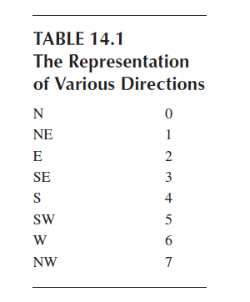
Robotics And Simulation Model

Slide 12
Genetic Algorithm
The first algorithm that we develop and implement for this problem of path planning is the genetic algorithm (GA)
This algorithm works by the principle of trying to find the best solution from some combination of the existing solutions. The whole algorithm proceeds in generations. Each generation is attempted to be better than the preceding one. This keeps improving the generations.
The main operators used are selection, crossover, and mutation.
The algorithm uses a fitness function to measure the fitness of various individuals. The role of the GA is to optimize the fitness of the individual. The final solution returned is the globally best available solution.

Slide 13
Genetic Algorithm
Representation
In this problem we have applied GA graphically
The solution is represented in the same manner, where the individuals are a collection of nodes or vertices of the graph that make the path.
The path consists of a series of vertices or nodes in between the source and the goal.
the solution or the individual representation in this case is of the form <P1, P2, P3….Pn>. Here each Pi denotes some node in the graph. P1 is the source, and Pn is the goal node; n is a variable number here. The path traced by the robot is P1 → P2 → P3 →… → Pn.
Each point Pi has three attributes associated with it. These are the x coordinate, the y coordinate, and the direction in which the robot is facing.
Any point can thus be represented by (x,y,d).
x = x coordinate, y = y coordinate, d = direction in which the robot is facing (between 0 to 7)

Slide 14
Genetic Algorithm
Evaluation of Fitness
The fitness function does the task of rating and comparing of the individuals of the GA. The goal of the GA is to generate solutions with an optimal fitness value.
The fitness function here is the number of nodes in the chromosomal representation of the individual. It may be seen that it represents the total distance traversed by the robot when implementing the solution represented by this individual. Hence we are optimizing the total path that needs to be traversed by the robot.
In case the individual represents a partial solution, i.e., a left solution or a right solution, there is an extra penalty that we add.
For the left solution, we take the distance between the last traversed point and the goal.
For the right solution, we take the distance between the source and the first traversed point.

Slide 15
Genetic Algorithm
Along with the penalty of the physical distance, another penalty is added to the partial solutions. This penalty is useful while comparing two individual that have the same physical distance measure as the penalty. This penalty is the cost needed to join the available solution with the solution that we assumed would be generated at the maximal cost of the physical distance penalty.
Consider Figure : If the direction is 2 (east) and the final position is just in front, R(n) has the value of 0. This means that the robot need not make any turn. It may simply march toward the goal. Keeping the positions of the goal and the robot as same, we get different values of R(n) for the different directions of the robot.
The R(n) term ensures that the number of rotations are minimal. As in the practical scenario, we need to avoid rotations as much as possible. Good solutions travel as straight as possible with as few turns as possible.

Slide 16
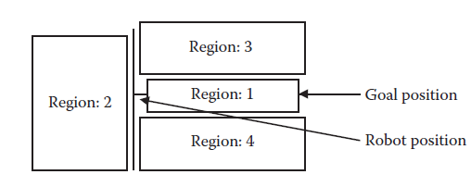
Genetic Algorithm
The values of R(n) at various places

Slide 17
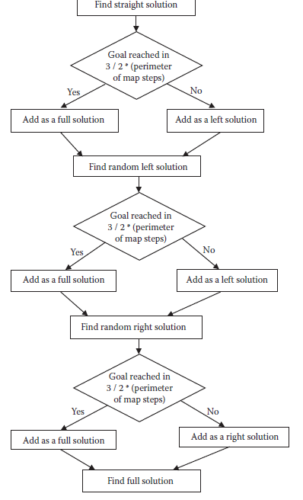
Genetic Algorithm
The steps for generating an
initial solution for the robot.

Slide 18
Genetic Algorithm
Initial Solutions
The initial solutions play a big role in the GA. They more or less define the scope of the solutions. The GA in the course of the generations tries to find more and more solutions based on the initial solutions generated.
The initial solution is found by applying the following strategies one by one.
Find a Straight Path Solution Between Source and Destination
From the source march straight ahead toward the destination. Whenever traveling at any point, there is a possibility of collision, take randomMoves (a number of random steps, turning in random directions in between).

Slide 19
Genetic Algorithm
FindStraightSolution(currentPoint,destinationPoint)
Step 1: for i ← 1 to (no of initial solutions intended)
Begin
Step 2: for j ← 1 to (3/2)*perimeter of map (Maximum moves per solution being tried)
Begin
Step 3: if p ← destinationPoint
Step 4: add p to current solution set and break
Step 5: find the move m in moves that brings the robot closest to destination
Step 6: if point p we reach after m is already in the current solution set, then delete earlier points and add this point
Step 7: if no move takes the robot closer to target
Step 8: make randomMoves number of random moves in any direction

Slide 20
Genetic Algorithm
Step 9: for each move m in these moves, if point p we reach after m is already in the current solution set, then delete earlier points and add this point
Step 10: if destinationPoint is reached, then add this solution set to fullSolution
Step 11: else add this solution set to leftSolution
Find Random Left Solution Between Source and Destination
At any point take random moves at any direction. Repeat doing this. Use direction = left in the algorithm FindRandomSolution.

Slide 21
Genetic Algorithm
Find Random Right Solution Between Source and Destination
At any point take random moves from the destination in any direction. Add every solution at the head of the final solutions sequence; so that it looks as if we approached the destination from a point. Repeat doing this. Use direction = right in the algorithm FindRandomSolution.
FindRandomSolution(currentPoint,destinationPoint,direction)
Step 1: p ← currentPoint
Step 2: for i ← 1 to noIterationsInitial
Begin
Step 3: for j ← 1 to (3/2)*perimeter of map
Begin
Step 4: if p ← destinationPoint
Step 5: add p to current solution set and break
Step 6: moves ← make a random move

Slide 22
Genetic Algorithm
Step 7: if point p we reach after move m is already in the current solution set then
Step 8: delete all points from the previous point p to end
Step 9: add p to the current solution set
Step 10: if destinationPoint is reached, then add this solution set to fullSolution
Step 11: else add it to the left or right solution, whichever is applicable.
Find Full Solutions
Once we have sufficient entries for the left and right solutions, there are chances of getting more full solutions from these data.
If you find any point in common between any solution of the left and right solutions, mix them to get a full solution.

Slide 23
Genetic Algorithm
if any of the left solutions is
(x11,y11,d11)(x12,y12,d12)…………........(xi,yi,di) (x1i+1,y1i+1,d1i+1)………………...(x1n,y1n,d1n)
and right solution is
(x21,y21,d21)(x22,y22,d22)…………(xi,yi,di) (x2i+1,y2i+1,d2i+1)………….….(x2n,y2n,d2n)
then the integrated full solution will be
(x11,y11,d11)(x12,y12,d12)………….(xi,yi,di) (x2i+1,y2i+1,d2i+1)……….….….(x2n,y2n,d2n)

Slide 24
Genetic Algorithm
FindSolutionFromLeftAndRight(currentPoint,destinationPoint)
Step 1: for each solution set s1 in leftSolution
Begin
Step 2: for each solution set s2 in rightSolution
Begin
Step 3: for each common point p in points
Begin
Step 4: sol1 ← all points in parent1 till p + rotations necessary to transform direction of p to the one of point p of parent2 + all points in parent2 after p
Step 5: Add sol1 to the fullSolution set

Slide 25
Genetic Algorithm
Crossover
Crossover is the genetic operator that generates a new individual by combining the parents. The new individual takes on characteristics from both the parents. In this problem, we use crossover to fuse existing solutions and to generate the new solutions.
Here we have a constraint for the parents of the GA. Not all parents can genetically reproduce. The crossover operation can only take place between the following pairs of parents :
Full Solution ( M) and Full Solution (F)
Left Solution (M) and Full Solution (F)
Full Solution (M) and Right Solution (F)
Left Solution (M) and Right solution (F)

Slide 26
Genetic Algorithm
The new individual has the initial or the left characteristics contributed by the male and the right ones contributed by the female.
If the left sequence selected is
(x11,y11,d11)(x12,y12,d12)…………........(xi,yi,di) (x1i+1,y1i+1,d1i+1)………………...(x1n,y1n,d1n)
and right sequence selected is
(x21,y21,d21)(x22,y22,d22)…………(xi,yi,di) (x2i+1,y2i+1,d2i+1)………….….(x2n,y2n,d2n)
The integrated full solution will be(x11,y11,d11)(x12,y12,d12)………….(xi,yi,di) (x2i+1,y2i+1,d2i+1)……….….….(x2n,y2n,d2n)

Slide 27
Genetic Algorithm
CrossOver(parent1,parent2)
Step 1: points ← find common points in parent1 and parent2 that have same x and y coordinate
Step 2: if points ≠ null
Step 3: for each common point p in points
Begin
Step 4: sol1 ← all points in parent1 till p + rotations necessary to transform
direction of p to the one of point p of parent2 + all points in parent2
after p
Step 5: Add sol1 to fullSolution set

Slide 28
Genetic Algorithm
Mutation
The mutation is the method by which we try to add newer characteristics to the system. This is important to ensure that the algorithm does not get converged at local minima due to the absence of characteristics.
Mutate()
Step 1: if number of solutions in full solution set > 0 then
Step 2: r1,r2 ← any two random points on a random solution from fullSolution set with r1 on the left of r2
Step 3: find solutions as found in initial solution with start point as r1 and goal point as r2
Step 4: if full results generated > 0
Step 5: newSolution ← most fit solution in this generated solution set

Slide 29
Genetic Algorithm
Step 7: sol1 ← all points in solution till r1 + rotations necessary to transform direction of r1 to the one of first point of newSolution + all points in newSolution + rotations necessary to transform direction of last point in newSolution to r2 + all points in solution after r2
Step 8: add sol1 to solutionFull

Slide 30
Artificial Network with Back Propagation Algorithm
The second algorithm we implement is the artificial neural network (ANN) with back propagation algorithm (BPA).
The ANN is used for the purpose of machine learning, i.e., the learning of the historical data. The ANN is able to reproduce the output whenever the input is again given.
It is known that the various conditions that affect the movement of a robot would repeat themselves over and over again in a given period of time. This means that if we learn the conditions and the calculated output or move of the robot.
The ANN takes as its input the robot’s current situation. The output of the ANN is the optimal next move. If we keep on inserting the conditions and executing the moves like this, we will get the optimal path that the robot must travel.

Slide 31
Artificial Network with Back Propagation Algorithm
Inputs
There are total 26 inputs to the neural network (I0 to I25). These are as follows:
The I0 and I1 denote the rotations needed for the robot to rotate from its present direction to the direction in which the goal is present. We know that the rotation can be –2 or +2 (180 degrees left or 180 degrees right), –1 (90 degrees left), 0 (no rotation), or else +1 (90 degrees right). These are represented by these two inputs as follows :
(I0,I1) = (0,0) represents +2 or –2
(I0,I1) = (0,1) represents +1
(I0,I1) = (1,1) represents 0
(I0,I1) = (1,0) represents –1

Slide 32
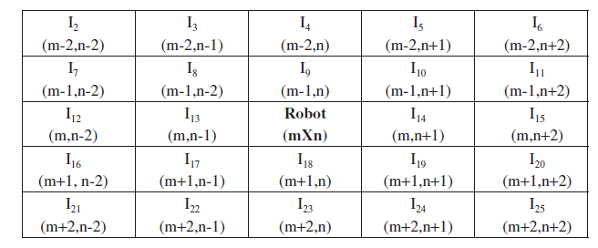
Artificial Network with Back Propagation Algorithm
The other bits (I2 to I25) represent the condition of the map. Considering the whole map as a grid of (M × N), we take a small portion of it (5 × 5), with the robot at the center of the map.
If (x,y) is the coordinate of the robot, we take (x–2,y–2)……(x+2,y+2) as the graph. These are 25 points.
The inputs for the artificial neural network.

Slide 33
Artificial Network with Back Propagation Algorithm
Explanation of the Outputs
There are total of three outputs (O0,O1,O2), each of which can be either 0 or 1.
The meanings of these outputs are as follows:
(O0, O1, O2) = (0,0,0) Rotate left 90 degrees.
(O0, O1, O2) = (0,0,1) Rotate left 45 degrees.
(O0, O1, O2) = (0,1,0) Move forward.
(O0, O1, O2) = (0,1,1) Rotate left 45 degrees and move forward.
(O0, O1, O2) = (1,0,0) Do not move.
(O0, O1, O2) = (1,0,1) Rotate right 90 degrees.
(O0, O1, O2) = (1,1,0) Rotate right 45 degrees and move forward.
(O0, O1, O2) = (1,1,1) Move right 45 degrees.

Slide 34
Artificial Network with Back Propagation Algorithm
Special Constraints Put in the Algorithm
There were a few limitations of the algorithm :
It may happen that the robot does not move or keeps turning in place continuously. Since there is no feedback in test mode, this is likely to continue indefinitely. For this, we apply the constraint that if the robot sits idle for more than five time stamps and does not make any move (excluding rotations), we take a random move.
It may happen that the robot develops an affinity to walk straight in a direction; hence if it is situated in the opposite direction, it may go farther and farther from the destination. For this we limit that if the robot makes five consecutive moves (excluding rotations) that increase its distance from the destination, we make the next one move only one that decreases its distance (excluding rotations).

Slide 35
Artificial Network with Back Propagation Algorithm
Procedure
The algorithm first generated test cases, so that the established neural network can be trained.
These are done by generating input conditions and solving them using A* algorithm and getting the inputs and outputs.
GenerateTestCases()
Step 1: initialize map and generate N obstacles at positions (xi,yi,di)
Step 2: while(noTestCaseGenerated < noTestCasesDesired)
Begin
Step 3: Generate the robot at random position (xi,yi,di)
Step 4: I ← Input sequence
Step 5: m ← getNextRobotMoveUsingAStar(CurrentPosition)
Step 6: moveRobot(m)
Step 7: O ← Output Sequence
Step 8: Add (I,O) to training data

Slide 36
Artificial Network with Back Propagation Algorithm
NavigationPlan()
Step 1: n ← Generate Neural Network
Step 2: n ← TrainNeuralNetwork()
Step 3: while(CurrentPosition ≠ FinalPosition)
Begin
Step 4: I ← generateInputSequence()
Step 5: O ← generateOutputSequence(I)
Step 6: if O gives valid move
Step 7: moveRobot(O)
Step 8: if robot not changed position in last five steps
Step 9: makeRandomMove()
Step 10: if distance of robot decreasing in last five steps (excluding rotations)
Step 11: move next move only if the next move decreases distance or is of equal distance

Slide 37
A* ALGORITHM
The A* algorithm tries to minimize the path traveled and the path that is left to be traveled. It hence tries to optimize the total path to be traveled by the robot.
This algorithm uses a heuristic function to optimize the path traversed from the start to the end. The algorithm used is the conventional A* algorithm to find out the goal (final position) starting from the initial position. In this algorithm, we use the following:
g(n) = depth from the initial node, increases by 1 in every step
h(n) = square of the distance of the current position and the final position + R(n)
r(n) = minimum time required for the robot to rotate in its entire journey assuming no
obstacles
f(n) = g(n) + h(n)
where n is any node.

Slide 38
A* ALGORITHM
gePath(CurrentPosition,GoalPosition)
Step 1: closed ← empty list
Step 2: add a node n in open such that position(n) = CurrentPosition
Step 3: while open is not empty
Begin
Step 4: extract the node n from open with the least priority
Step 5: if n = final position then break
Step 6: else
Step 7: moves ← all possible moves from the position n
Step 8: for each move m in moves
Begin
Step 9: if m leads us to a point that can be the point of any obstacle in the next unit time, then discard move m and continue
Step 10: if m is already in the open list and is equally good or better, then discard this move

Slide 39
A* ALGORITHM
Step 11: if m is already in closed list and is equally good or better, then discard this move
Step 12: delete m from open and closed lists
Step 13: make m as new node with parent n
Step 14: Add node m to open
Step 15: Add n to closed
Step 16: Remove n from open

Slide 40
Comparisons
We studied three different algorithms for robotic path planning, i.e., GA, ANN with BPA, and the A* algorithm.
GA takes a long time for generation of good results as compared to ANN and BPA. However, it is an iterative algorithm.
The A* version fails because of the large input size, then GA can be used as a very effective algorithm.
The A* is the best algorithm that gives us the optimal solutions. The optimality is better than for the ANN or the GA.
The ANN gives very fast results and leads to a very quick generation of a path. The path, however, may not be optimal.
The ANN gives very fast results and leads to a very quick generation of a path. The path, however, may not be optimal.

Slide 41
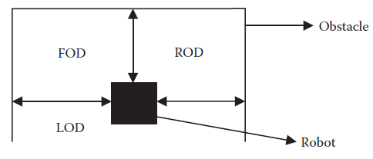
Robotic Controller
we have identified four inputs of the system. These are
Left Obstacle Distance (LOD)
Right Obstacle Distance (ROD)
Forward Obstacle Distance (FOD)
Target Angle (TA).
The system outputs the steering angle. The robot needs to turn using this steering angle in order to reach the goal without collision with the obstacles.
The Inputs to the adaptive neuro-fuzzy inference system.

Slide 42
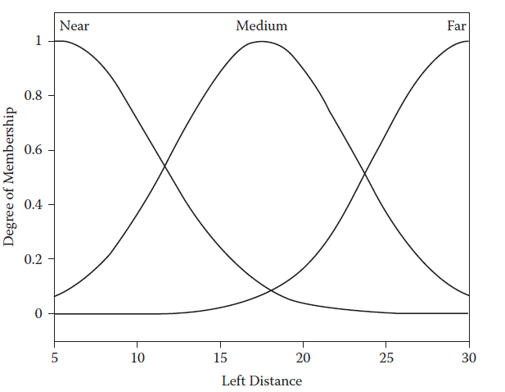
Robotic Controller
Rules
A total of 81 rules were generated in order to effectively control the robot using the designed controller. Here are some of these rules:
If (left_distance is near) and (right_distance is near) and ( front_distance is near) and (target angle is negative), then (steering angle is positive).
Membership functions
for left obstacle distance

Slide 43
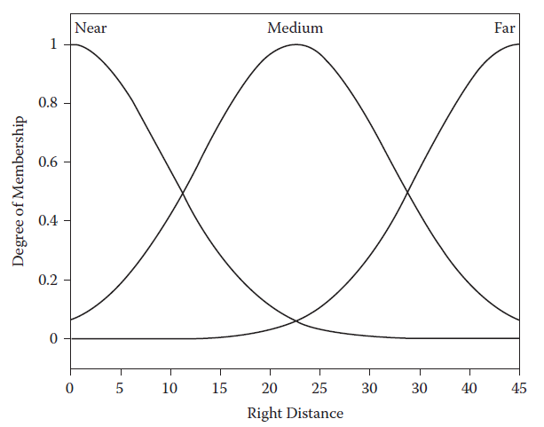
Robotic Controller
Rule 2:
If (left_distance is near) and (right_distance is near) and ( front_distance is near) and (target
angle is zero), then (steering angle is positive).
Membership functions for
right obstacle distance.

Slide 44
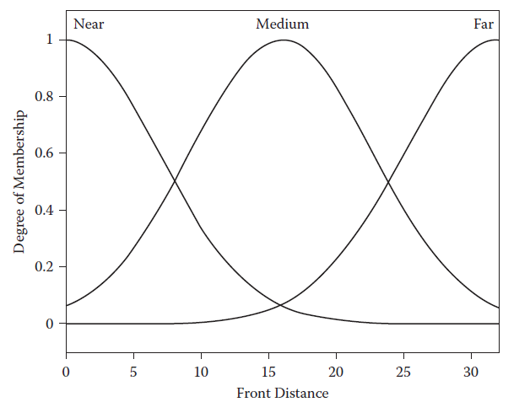
Robotic Controller
Membership functions for
front obstacle distance
Membership functions for
left obstacle distance.

Slide 45
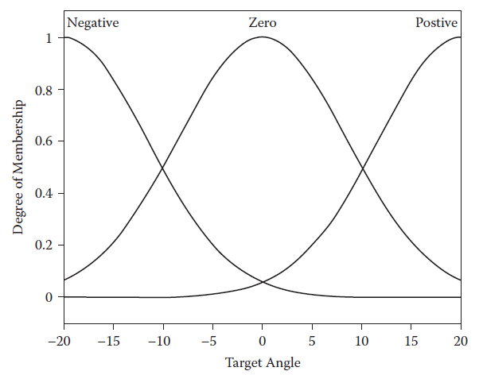
Robotic Controller
Membership functions for
target angle.

Slide 46
Robotic Controller
Rule 3:
If (left_distance is near) and (right_distance is near) and ( front_distance is near) and (target angle is positive), then (steering angle is negative).
Rule 4:
If (left_distance is near) and (right_distance is near) and ( front_distance is medium) and (target angle is negative), then (steering angle is positive).
Rule 5:
If (left_distance is near) and (right_distance is near) and ( front_distance is medium) and (target angle is zero), then (steering angle is zero).
Rule 6:
If (left_distance is near) and (right_distance is near) and ( front_distance is medium) and (target angle is positive), then (steering angle is negative).

Slide 47
Robotic Controller
Rule 7:
If (left_distance is near) and (right_distance is near) and ( front_distance is far) and (target angle is negative), then (steering angle is positive).
Rule 8:
If (left_distance is near) and (right_distance is near) and ( front_distance is far) and (target angle is zero), then (steering angle is zero).
Rule 9:
If (left_distance is near) and (right_distance is near) and ( front_distance is far) and (target angle is positive), then (steering angle is negative).
Rule 10:
If (left_distance is far) and (right_distance is near) and ( front_distance is near) and (target angle is negative), then (steering angle is positive).

Slide 48
Robotic Controller
Rule 11:
If (left_distance is far) and (right_distance is near) and ( front_distance is near) and (target angle is zero), then (steering angle is positive).
Rule 12:
If (left_distance is far) and (right_distance is near) and (front_distance is near) and (target angle is positive), then (steering angle is negative).

Slide 49
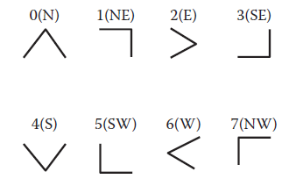
Results
The testing of the system was done using Java as a platform. Here we randomly generated various obstacles. The robot was controlled by the path planning algorithm. The algorithm moved the robot from the start position and made it reach the goal position.

Slide 50
Results
Genetic Algorithm
We had used a sample grid space on which the robot is to be moved that was [100 × 100] in dimension. The coordinates could vary from (0, 0) to (99, 99). We used total 750 obstacles, which all could move a unit step at any unit time. The threshold time was fixed to be 9 seconds. We moved the robot from position (0, 0) to the goal position (99, 99).
Artificial Neural Networks
The parameters were quite similar to the ones used in the previous algorithm. The sample grid space on which the robot is to be moved was [100 × 100] in dimension, where the coordinates could vary from (1, 1) to (100,100).
MATLAB was used for the simulation.

Slide 51
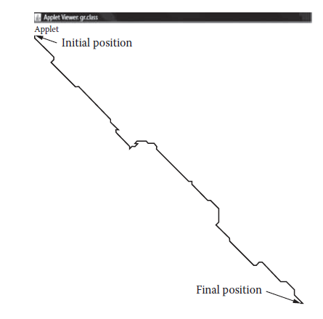
Results
The result of the first run of the genetic algorithm.

Slide 52
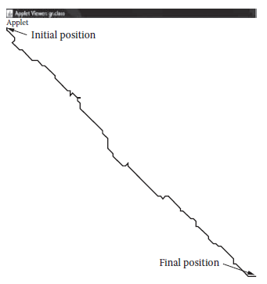
Results
A* Algorithm
Here also the grid size was [100 × 100]. The coordinates could vary from (0, 0) to (99, 99). We used a total of 1,000 obstacles, which all could move a unit step at any unit time. The threshold time was fixed to be 1 second. We moved the robot from position (0, 0) to the goal position (99, 99).
The result of the third run
of the genetic algorithm.

Slide 53
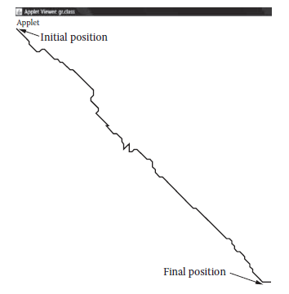
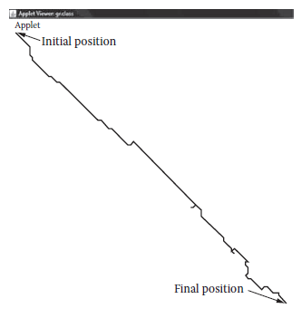
Results
The result of the third run of
the genetic algorithm.
The result of the fourth run of
the genetic algorithm.

Slide 54
Results
Stationary phase:
In this phase the robot is completely stationary. This happens because there is no way that the robot can reach the goal.
Straight phase :
This is the most desirable kind of phase, where the robot marches ahead in almost a straight-line path. This is when there are no obstacles at all or there are very few obstacles in the path of the robot and the goal.
Collision avoidance phase :
If an obstacle is very close to the robot, it takes a sharp turn to avoid collision and keep going.

Slide 55
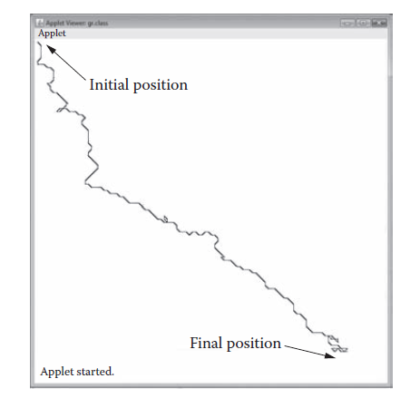
Results
Backtracking phase:
If the robot happens to deviate greatly from its path due to an excessive number of obstacles in its close vicinity, it backtracks to its path and then continues to move further.
The result of the second run of
the artificial neural network.

Slide 56
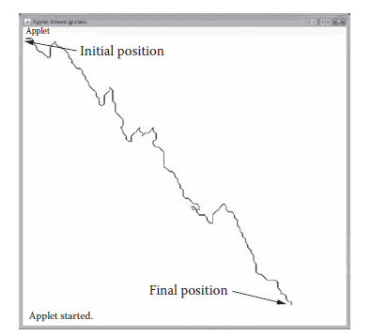
Results
Robotic Controller
This section presents the experimental results that show the performance of the neuro-fuzzy system. The results were simulated on MATLAB.
The result of the third run of
the artificial neural network.

Slide 57
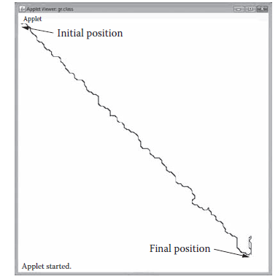
Results
The result of the second run of
the A* algorithm.

Slide 58
Conclusions
We solved the problem of path planning using three algorithms: GA, ANN with BPA, and the A* algorithm.
In all cases, we saw that the algorithms were able to solve the problem and gave reasonable and optimal solutions in the map that was given to the algorithm as input. We also compared the three algorithms over numerous issues and studied which one would perform better under what circumstances.
The result of the third run of
the A* algorithm.

Slide 59
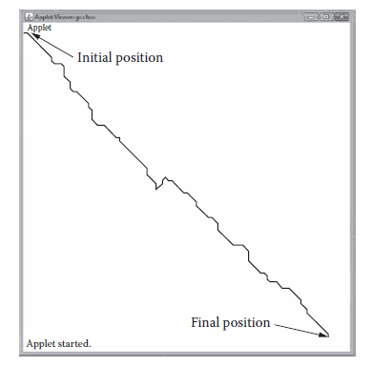
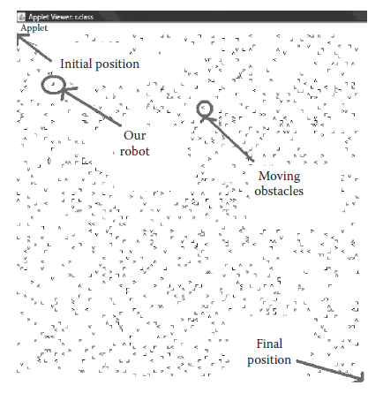
Conclusions
The result of the fourth run of the
A* algorithm.
Obstacles and robot in motion.

Slide 60
Conclusions
We also compared the three algorithms over numerous issues and studied which one would perform better under what circumstances. We even studied the algorithmic performance over randomly generated obstacles.
The first algorithm studied was GA. Here we observed that the algorithm takes a time for the generation of a really optimal solution.
The second algorithm that we studied was the ANN. Here we saw that the algorithm learns from the past data that for implementation purposes we had generated using A* algorithm results.

Slide 61
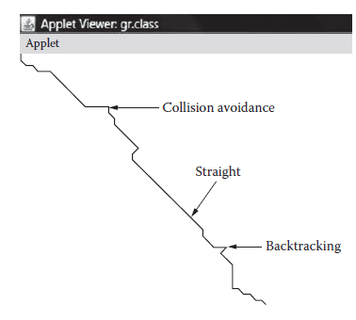
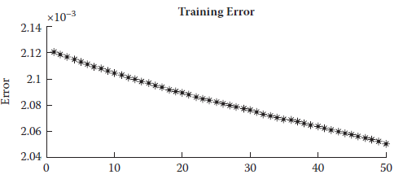
Conclusions
The various types of paths in
the motion of robot.
Plot errors during the training
of ANFIS structure.

Slide 62
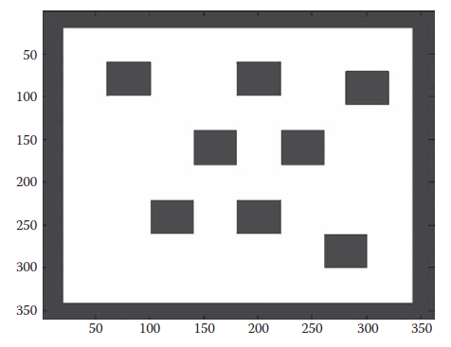
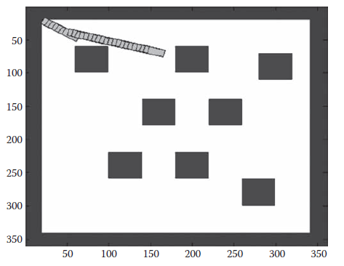
Conclusions
Snapshot of the environment
with eight obstacles.
Motion of the robot in the
environment with eight obstacles
at the middle of the journey.

Slide 63
Conclusions
The last algorithm used was the A* algorithm. The algorithm was very efficient in terms of both time and the optimality of the path generated. We, however, further argued that the algorithm may face problem in the case of large and complex maps.
This chapter further discussed the implementation and the design of neuro-fuzzy robotic controller. This was used to move the robot on the map by using a rule-based fuzzy approach optimized byANN learning. The controller guided the robot from the source to the destination. The robot moved well and very optimally covered the entire path.

Slide 64
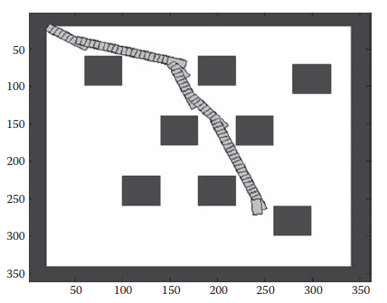
Conclusions
Motion of the robot in the
environment with eight obstacles
toward the end of the journey.
We discussed the pros and cons of the various algorithms that we used. Drawing on these algorithms and other available algorithms, we may develop hybrid algorithms or implement these algorithms in a hierarchical manner such that all the good features of the individual algorithms join together to yield a better algorithm that is much less limited over a wide variety of map and constraints.

